Slide 1
Unit 1

Slide 2
Introduction to Internet
Internet is called a network as it creates a network by connecting computers and servers across the world using routers, switches and telephone lines, and other communication devices and channels.
Internet is defined as an Information super Highway, to access information over the web. However, It can be defined in many ways as follows
Internet is a world-wide global system of interconnected computer networks.

Slide 3
Internet uses the standard Internet Protocol (TCP/IP).
Every computer in internet is identified by a unique IP address.
IP Address is a unique set of numbers (such as 110.22.33.114) which identifies a computer location.
A special computer DNS (Domain Name Server) is used to give name to the IP Address so that user can locate a computer by a name.

Slide 4
For example, a DNS server will resolve a name https://www.vtcbb.edu.in to a particular IP address to uniquely identify the computer on which this website is hosted.
Internet is accessible to every user all over the world.

Slide 5
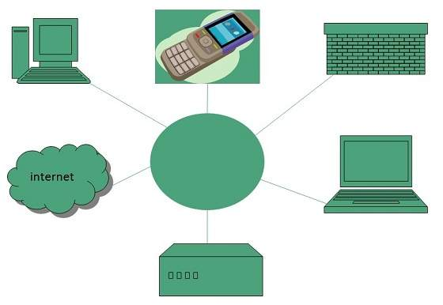

Slide 6
Evolution of Internet
The concept of Internet was originated in 1969 and has undergone several technological & Infrastructural changes as discussed below:
The origin of Internet devised from the concept of Advanced Research Project Agency Network (ARPANET).
ARPANET was developed by United States Department of Defense.
Basic purpose of ARPANET was to provide communication among the various bodies of government.

Slide 7
Initially, there were only four nodes, formally called Hosts.
In 1972, the ARPANET spread over the globel with 23 nodes located at different countries and thus became known as Internet.
By the time, with invention of new technologies such as TCP/IP protocols, DNS, WWW, browsers, scripting languages etc.,Internet provided a medium to publish and access information over the web.

Slide 8
Internet Services
Internet Services allows us to access huge amount of information such as text, graphics, sound and software over the internet. Following diagram shows the four different categories of Internet Services.

Slide 9
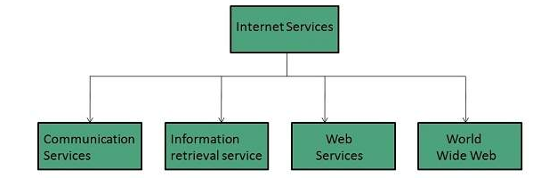

Slide 10
Communication Services
There are various Communication Services available that offer exchange of information with individuals or groups.
The following services gives a brief introduction to these services.
Electronic Mail Used to send electronic message over the internet.
Telnet Used to log on to a remote computer that is attached to internet.

Slide 11
Newsgroup Offers a forum for people to discuss topics of common interests.
Internet Relay Chat (IRC) Allows the people from all over the world to communicate in real time.
Mailing Lists Used to organize group of internet users to share common information through e-mail.

Slide 12
Internet Telephony (VoIP) Allows the internet users to talk across internet to any PC equipped to receive the call.
Instant Messaging Offers real time chat between individuals and group of people. Eg. Yahoo messenger, MSN messenger.

Slide 13
Information Retrieval Services
There exist several Information retrieval services offering easy access to information present on the internet. The following table gives a brief introduction to these services:
File Transfer Protocol (FTP) Enable the users to transfer files.

Slide 14
Web Services
Web services allow exchange of information between applications on the web. Using web services, applications can easily interact with each other.

Slide 15
World Wide Web (WWW)
WWW is also known as W3. It offers a way to access documents spread over the several servers over the internet. These documents may contain texts, graphics, audio, video, hyperlinks. The hyperlinks allow the users to navigate between the documents.

Slide 16
Advantages of Internet
Communication Forum – The speed of communication becomes faster which is obtained through the web. Families and friends can confine touch easily. The platform for products like SKYPE allows for holding a video conference with anyone within the world who also has access.
Abundant Information – Anyone can find information on almost any imaginable subject. Plenty of resources are often found through the program in minutes.
Inexhaustible Education – For instance, students can gain readily available help for his or her homework online.

Slide 17
Entertainment for everybody – Most folks love using our laptops, smartphones, and, tablets. The web is that the big reason behind us spending such a lot of time on these gadgets.
Online Services and E-commerce – Many services of emails, online banking, online shopping, etc are there. Free mail to anyone is definitely accessible all around the world. E-commerce enables one in America to shop for things in Asia, Africa, or other areas within the world through some simple clicks of the mouse.

Slide 18
Social network – Social networking is the sharing of data with people across the planet. Aside from being an entertainment website, it’s many uses.
Learning – The web has now become a neighborhood of education. Education like homeschooling is definitely administered using the web. Teachers can upload their teaching videos on the web

Slide 19
Disadvantages of Internet
Internet Addiction Disorder – Internet addiction is detrimental to not only fitness but also psychological state.
Cyber Crime – Hacker programs a virus which gets into the pc and ruins valuable data. Users’ personal information like name, address, master card, bank details, and other information are often accessed by culprits when used on the web, leading to significant economic loss.

Slide 20
Social Alienation – Time spent online flies fast without consciousness. After getting attracted the user trapped into the trap, users are trapped by a “net”, spending less time with people in the real world. Less interaction and face-to-face communication, actually, may end in a decrease in social abilities.
Spam – The unnecessary emails, advertisements, etc. are sometimes said to be spam because they need the power to hamper the system and make the users face many problems.

Slide 21
Internet Connection

Slide 22
Types of Internet Connection
Dial-up Connection :
Dial-up connection uses telephone line to connect PC to the internet. It requires a modem to setup dial-up connection. This modem works as an interface between PC and the telephone line.
There is also a communication program that instructs the modem to make a call to specific number provided by an ISP.

Slide 23
Dial-up connection uses either of the following protocols:
Serial Line Internet Protocol (SLIP)
Point to Point Protocol (PPP)
The following diagram shows the accessing internet using modem:

Slide 24
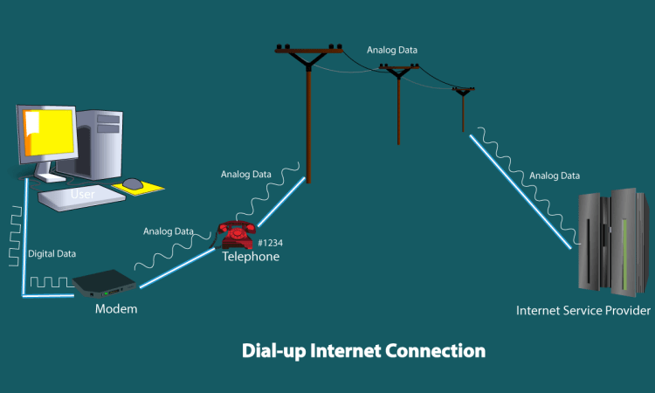

Slide 25
2) Leased Connection :
A Leased line connection is s telephone line that has been Leased for Private use. In some contexts, its called dedicated line.
A Leased line is usually contrasted with a switched line or dial-up line.
Leased line are dedicated line directly from the ISP to the subscriber.
The speed available are in the range of 9.6 kbps to 2 mbps.

Slide 26
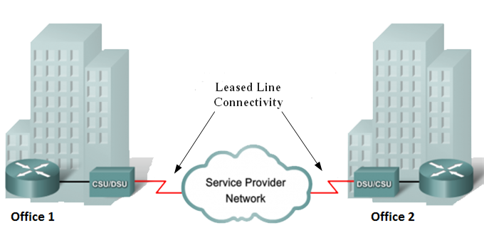

Slide 27
3) Broadband Connection :
The term “broadband” is shorthand for “broad bandwidth,” and it offers significantly better high-speed connections than dial-up.
This high-speed Internet connection is provided through either cable or telephone companies.
One of the fastest options available, broadband Internet uses multiple data channels to send large quantities of information.

Slide 28
Broadband Internet connections such as DSL and cable are considered high-bandwidth connections. Although many DSL(Digital subscriber line ) connections can be considered broadband, not all broadband connections are DSL.

Slide 29
4) Wi-Fi :
The abbreviation “WiFi” has almost become synonymous with “internet” these days, but it refers to a specific kind of internet connection that utilizes radio frequencies rather than phone or cable lines.
it can be access from anywhere within network range.
It’s one of the fastest options on the market.

Slide 30
5) Mobile broadband :
mobile broadband connections operate at faster speeds than most home wireless broadband plans and offer more flexibility.
SIM-only mobile broadband plans allow you to use it with your own hotspot, tablet, and other devices.
Alternatively, dongles and portable mobile hotspots used with broadband plans are generally battery-powered, so they’re also great for moving around.

Slide 31
6) Mobile Hotspot :
A mobile hotspot can deliver a strong, fast and secure online connection just about wherever you go. Like a mobile phone, but without the ability to make calls, a mobile hotspot is all about data.
It works by taking an LTE(Long-Term Evolution) connection and converting it into a wi-fi signal that your laptop or smartphone can use.

Slide 32
7) Cable Connection :
Cable connection is provided through Cable TV lines. It uses coaxial cable which is capable of transferring data at much higher speed than common telephone line.
Key Points:
A cable modem is used to access this service, provided by the cable operator.
The Cable modem comprises of two connections: one for internet service and other for Cable TV signals.
Since Cable TV internet connections share a set amount of bandwidth with a group of customers, therefore, data transfer rate also depends on number of customers using the internet at the same time.

Slide 33
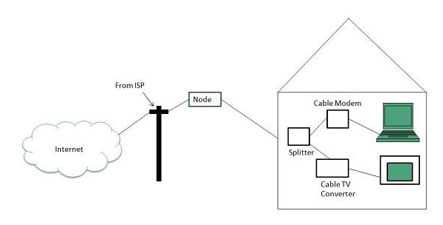

Slide 34
Working of Internet
The Internet works through a packet routing network in accordance with the Internet Protocol (IP), the Transport Control Protocol (TCP) and other protocols.
All the computers and networks connected by the Internet work,because they follow a simple rules.

Slide 35
TCP/IP breaks all data into small packets, and the first part of each packet has the address, where the packet is meant to go.
There is no central computer or authority.

Slide 36
What’s a protocol?
A protocol is a set of rules specifying how computers should communicate with each other over a network.
What’s a packet?
Data sent across the Internet is called a message. Before a message is sent, it is first split in many fragments called packets.

Slide 37
 | Internet | Intranet | Extranet
1 | A global network which is available to anyone who wants to access information | An intranet is unique to an organization or group of people who work together at a place | Extranet is for individuals or group of personnel who want to send private information
2 | Public | Private | Private
3 | Independent | Independent yet dependent on internet | Dependent on internet and intranet
4 | Global system. | Specific to an organization. | To share information with suppliers and vendors it male the use of public network.
5 | All over the world. | Restricted area upto an organization. | Restricted area upto an organization and some of its stakeholders or so.
6 | It is largest in number of connected devices. | The minimal number of devices are connected. | The connected devices are comparable with Intranet.
7 | Not secured | Secured | Secured
8 | Not owner by anyone | Owned by a particular Organization. | Owned by a one or more Organizations.

